Slide 1
Plasma Diagnostic Techniques Lecture 17: Absorption spectroscopy
York Plasma Institute

Slide 2
Recap: Radiative transfer

Slide 3
Optical transitions: photon absorption
Photon absorption
The Einstein coefficient B_{ki} describes the transition probability for photon absorption from a lower energy level k to a higher energy level i.
i
k
The discrete (line absorption) energy E_{ki} of the corresponding photon is directly related to the frequency ν_{ki} (wavelength λ_{ki}) of the absorbed photon.
The number of absorbed photons per unit volume and time is given by:

Slide 4
Recap: Line profiles

Slide 5
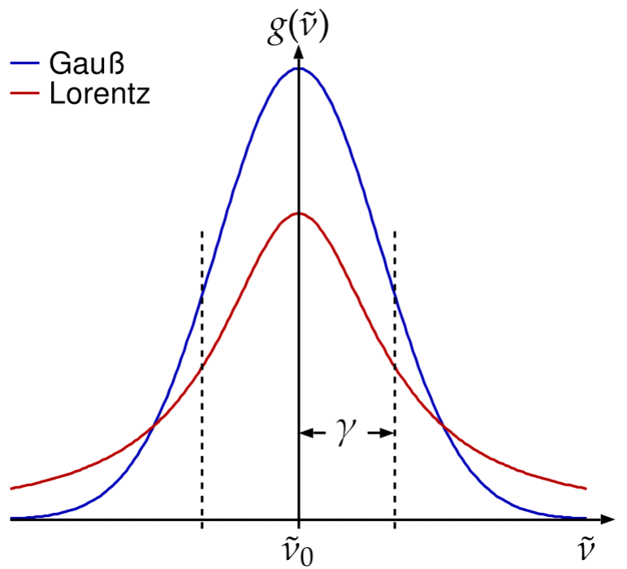
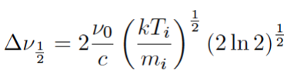
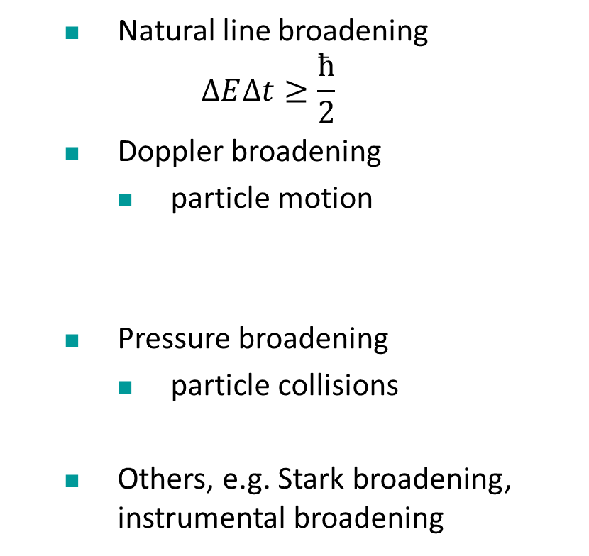
Spectral line profiles φ(λ)
Natural line broadening
$$∆E∆t≥\frac{\text{ħ}}{2}$$
Doppler broadening
particle motion
Pressure broadening
particle collisions
Others, e.g. Stark broadening, instrumental broadening

Slide 6
Principles of Absorption Spectroscopy

Slide 7
Principles of AS
Light source
Plasma
Detector
Use light for excitation!
Therefore, AS is
Direct (no model needed, in contrast to emission based techniques)
Relatively easy to implement
Invasive (but not too much)
No spatial resolution

Slide 8
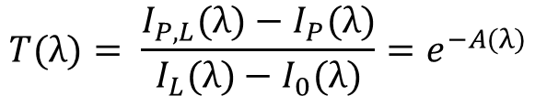
Beer-Lambert-Law
I_{L}
I_{P}
I_{P,L}
Define transmission
$$T(λ)= \frac{I_{P,L}(λ)−I_{P}(λ)}{I_{L}(λ)−I_{0}(λ)}{=e}^{−A(λ)}$$
λ
A absorbance
I(x)
2 Signals…
I_{L} Intensity of light source
I_{P,L} Intensity after light passed medium
I_{L}
Exponential decay!
… + 2 signals
I_{P} Correction for plasma emission
I₀ Background correction
x

Slide 9

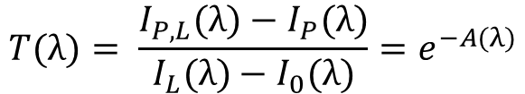
Beer-Lambert-Law
$$T(λ)= \frac{I_{P,L}(λ)−I_{P}(λ)}{I_{L}(λ)−I_{0}(λ)}{=e}^{−A(λ)}$$
How to get densities? Let’s have a look at the absorbance
$A\left(λ\right)=n_{k} l σki\left(λ\right)=α\left(λ\right)l$
n species density (lower energy level)
l absorption length
σ(λ) absorption cross section
α absorption coefficient
i
k
σ is a measure for the probability of the transition

Slide 10
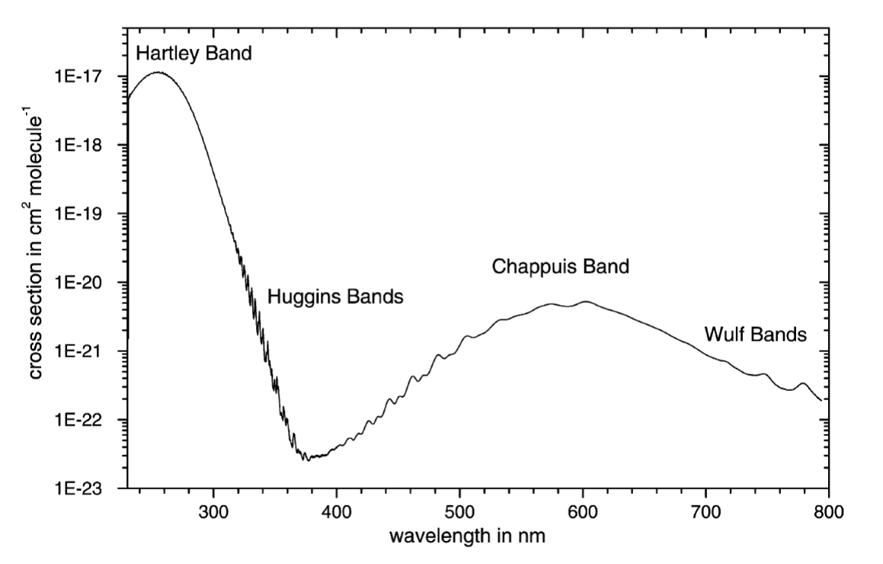
Absorption cross sections
O₃ absorption cross sections

Slide 11


AS and line profiles
$$T(λ)= \frac{I_{P,L}(λ)−I_{P}(λ)}{I_{L}(λ)−I_{0}(λ)}{=e}^{−A(λ)}$$
α is a measure for the probability of the transition and usually contains the normalised line profile φ(λ)
$A\left(λ\right)=n_{k} σki\left(λ\right)l=α\left(λ\right)l$
$α\left(λ\right)= α\left(λ_{0}\right)ϕ\left(λ−λ_{0}\right)$
Integration over line-profile necessary

Slide 12
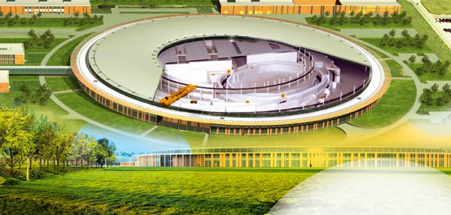
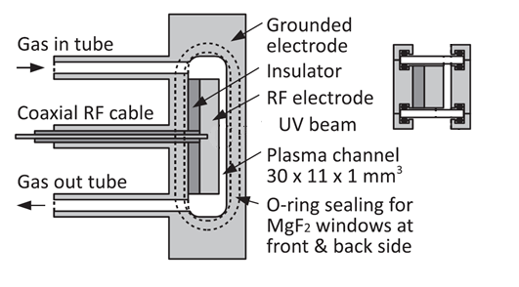
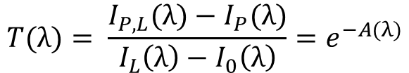
AS on atomic species
$$T(λ)= \frac{I_{P,L}(λ)−I_{P}(λ)}{I_{L}\left(λ\right)−I_{0}\left(λ\right)}{=e}^{−A(λ)}$$
Simplest case: Electronic transitions in atoms
Atomic oxygen
O (3s ³S₁₎
Atmospheric pressure plasma:
130 nm
O(2p⁴ ³P₂)
Ground state
Niemi et al., APL, 2013

Slide 13
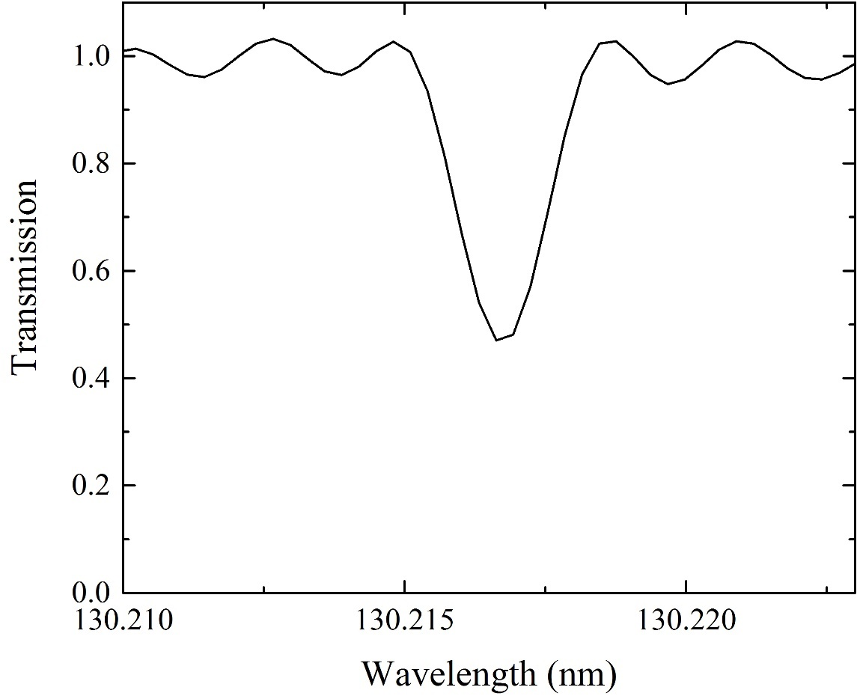
AS on atomic species
$$T(λ)= \frac{I_{P,L}(λ)−I_{P}(λ)}{I_{L}(λ)−I_{0}(λ)}{=e}^{−A(λ)}$$
Vacuum Ultra-Violet AS on atomic oxygen
Simplest case: Electronic transitions in atoms
Atomic oxygen
O (3s ³S₁₎
Single line profile with Doppler and pressured broadened line
130 nm
O(2p⁴ ³P₂)
Ground state

Slide 14
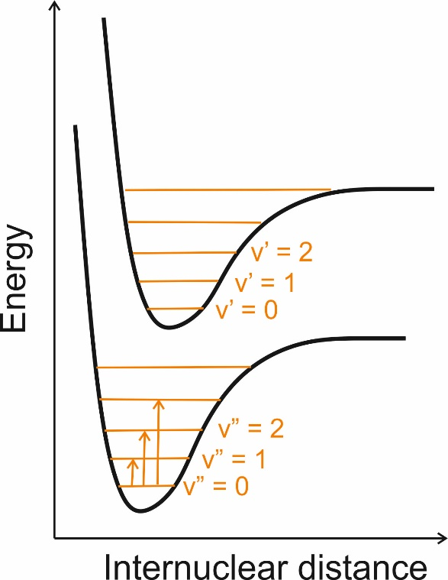



AS on molecules
Electronic, rotational and vibrational transitions
Linear molecules
Non-linear molecules
e.g. OH
e.g. CO₂
e.g. H₂O
Vibration:
Symmetric stretch
Asymmetric stretch
Bending
The energy required for vibr. excitation depends on mode of vibration, bond strength, and mass of atoms. Imagine bond as a spring:
𝜆 in infra-red (IR) spectral range
$$E=\frac{hc}{λ^{}}$$
ν wavenumber (in cm⁻¹)
$$v=\frac{1}{λ}$$

Slide 15

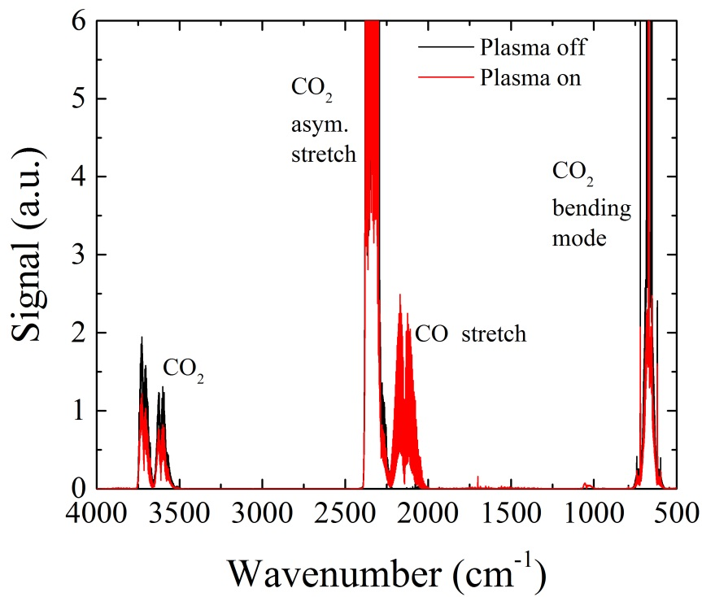
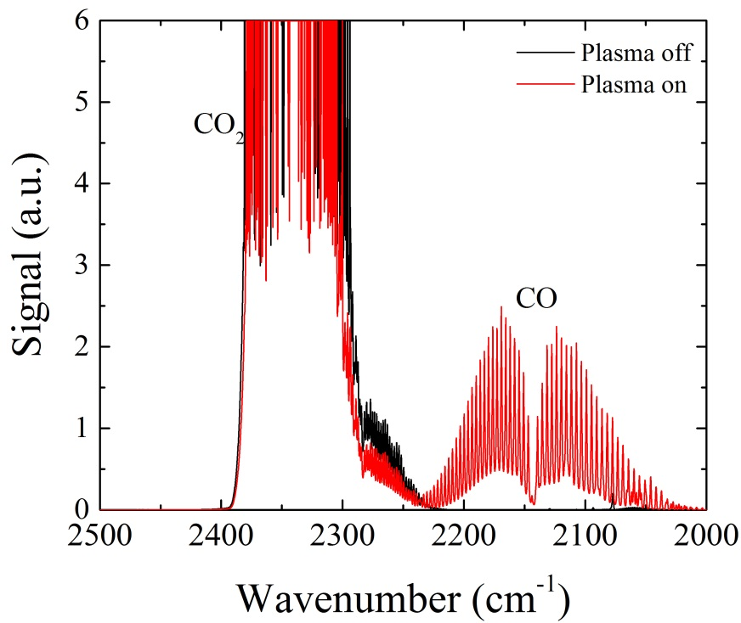
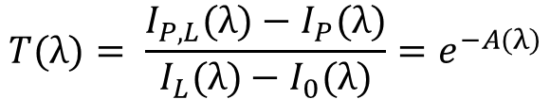
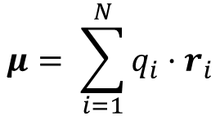
+
AS on molecules – IR spectroscopy
To detect molecules with IR-spectroscopy, dipole moment has to change!
Not detectable (CO₂ sym. stretch)
Detectable (CO₂ asym. stretch)
$$μ= \sum_{i=1}^{N}{q_{i}·r_{i}}$$
-
+
-
-
+
-
$$T(λ)= \frac{I_{P,L}(λ)−I_{P}(λ)}{I_{L}(λ)−I_{0}(λ)}{=e}^{−A(λ)}$$
IR AS on CO₂: CO₂(v”) → CO₂ (v’)
Ar + CO₂

Slide 16
AS on molecules
Electronic, rotational and vibrational transitions
Linear molecules
Non-linear molecules
e.g. OH
e.g. CO₂
e.g. H₂O
Vibration:
Symmetric stretch
Asymmetric stretch
Vibrational quantum numbers
Bending
Rotation:
Rotational quantum numbers

Slide 17
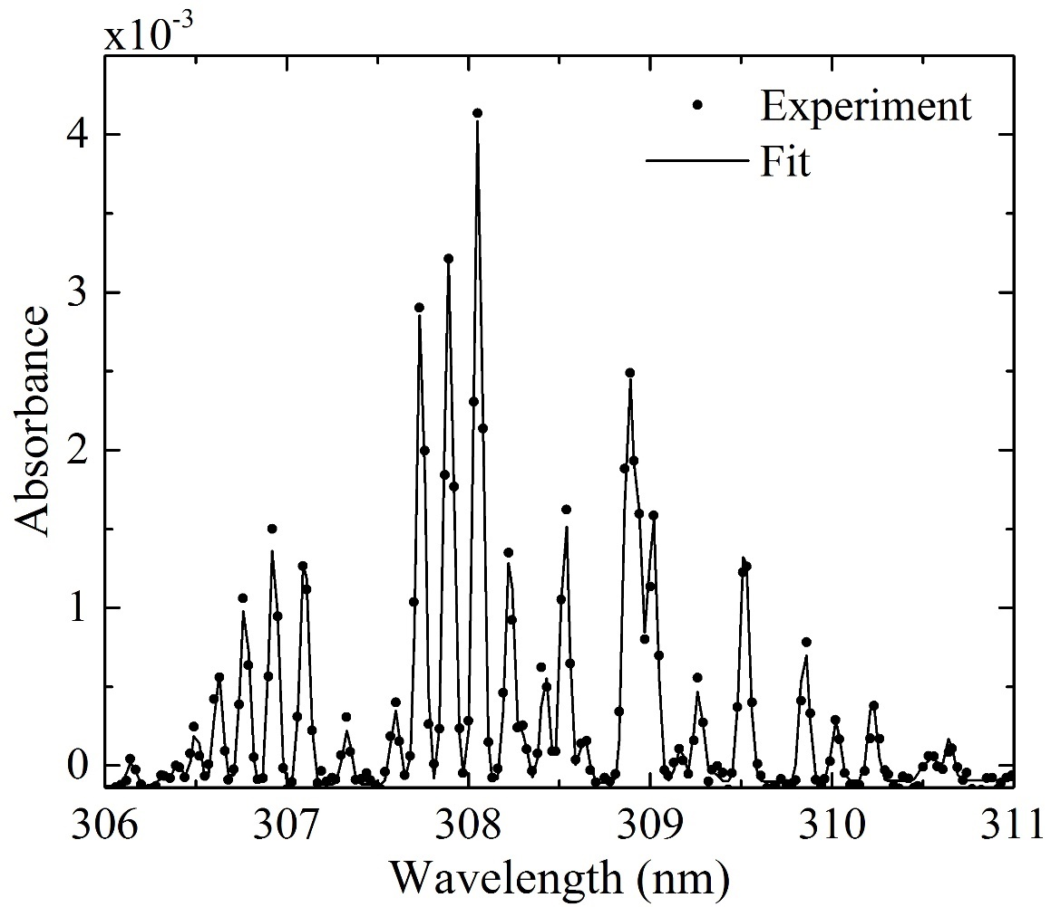
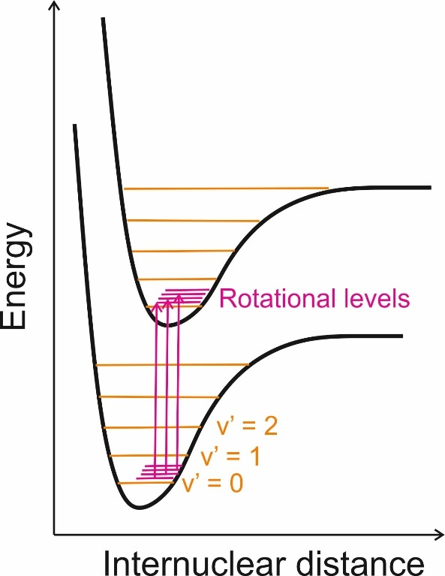
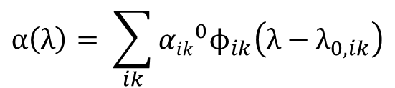
AS on molecules - UV spectroscopy
$$T(λ)= \frac{I_{P,L}(λ)−I_{P}(λ)}{I_{L}(λ)−I_{0}(λ)}{=e}^{−A(λ)}$$
UV AS on hydroxyl radicals (OH)
OH(X,v”=0) → OH(A,v’=0)
Rotational transitions in molecules
Multiple lines, instrumental broadening dominant
$$α\left(λ\right)= \sum_{ik}{{{αik}_{}^{0}ϕ}_{ik}\left(λ−λ_{0,ik}\right)}$$
i,k are different rotational levels!

Slide 18
AS summary
In principle AS can be used to detect any species of interest, as long as
cross sections are known
species densities are not too high/low
desired wavelength is “accessible”

Slide 19
Apparatus for absorption Spectroscopy

Slide 20
AS setup
3 components:
Light source (tunable or broad-band)
LED
Diode lasers
Plasma lamps
Synchrotron radiation
Optics (beam “shaping”, e.g. focussing or collimating)
Detector (coupled with spectrometer)
Photodiode arrays
CCD chips

Slide 21
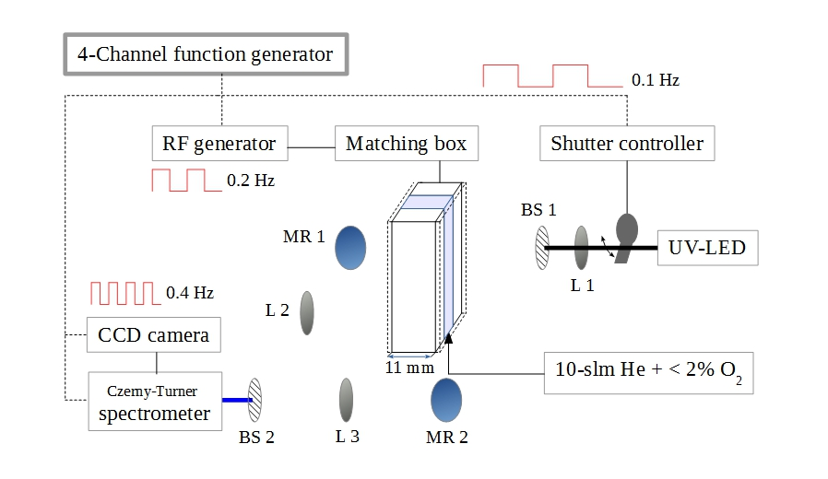
Experimental Setup
Probe beam
Reference beam (usually not necessary)

Slide 22
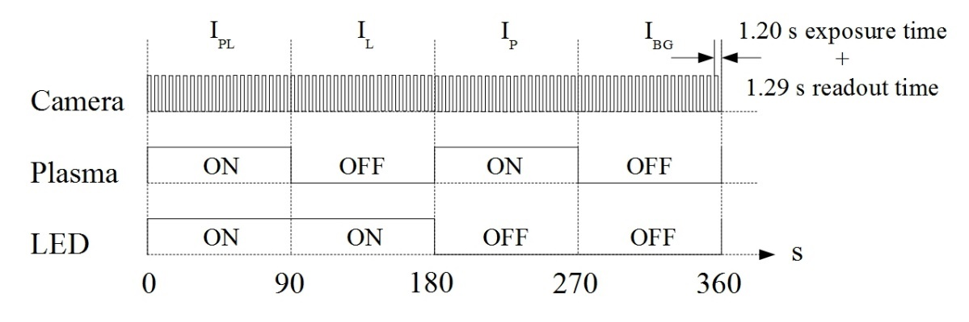
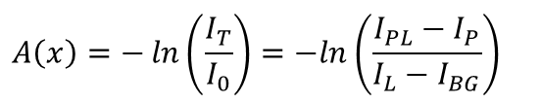
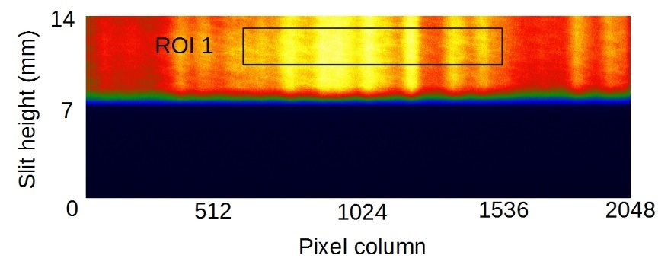
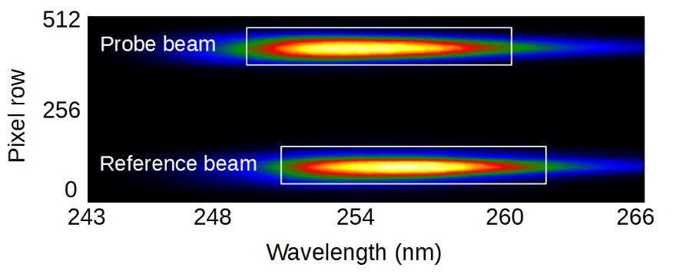
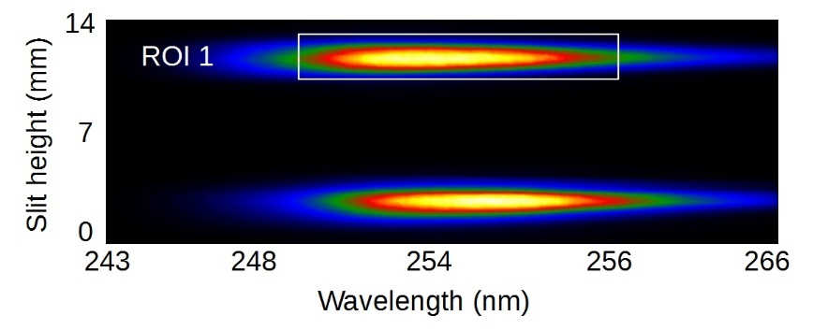
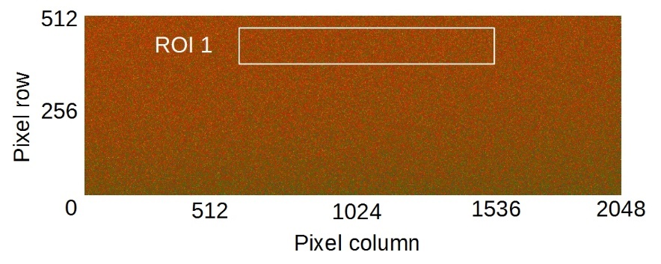
Experimental Procedure
Plasma + LED (I_{PL})
Plasma (I_{P})
LED (I_{L})
Background (I_{BG})

Slide 23
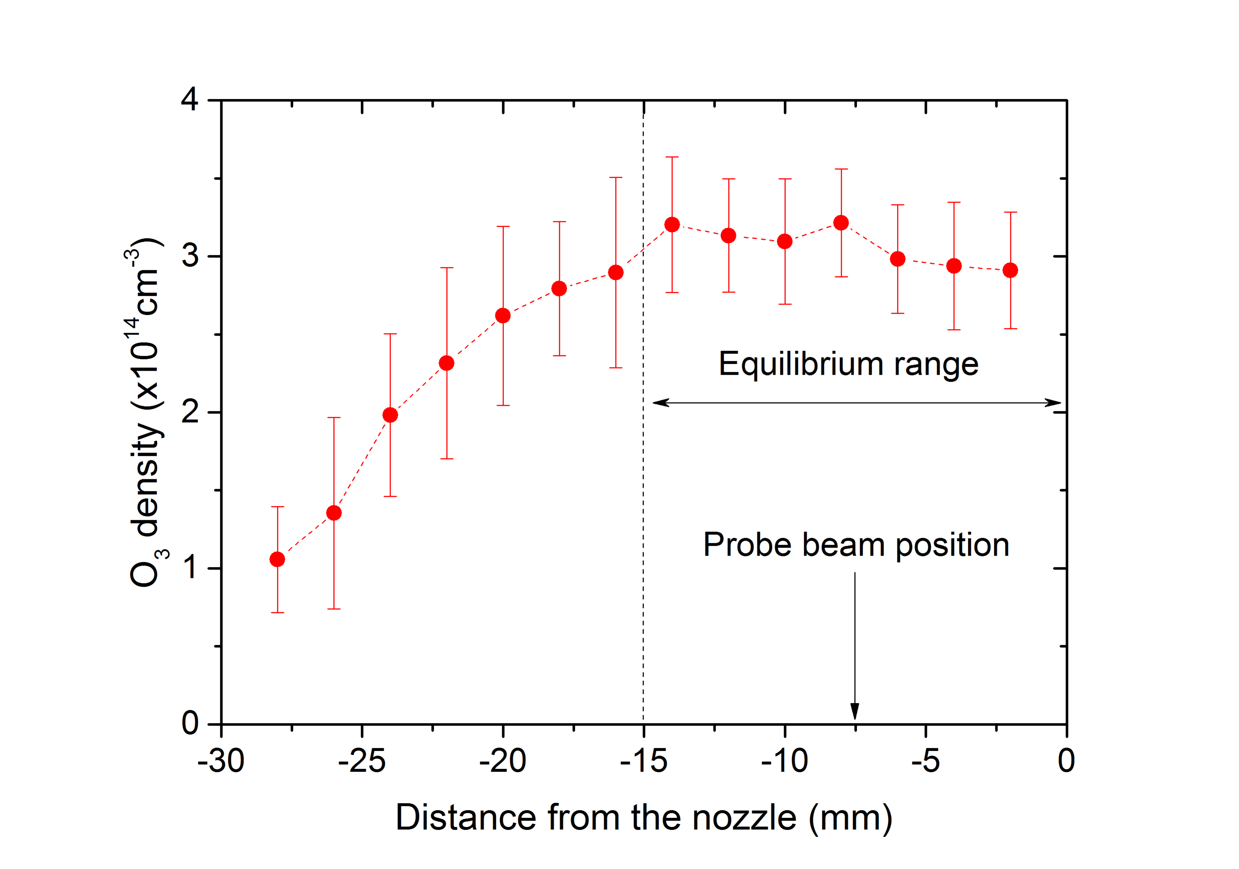
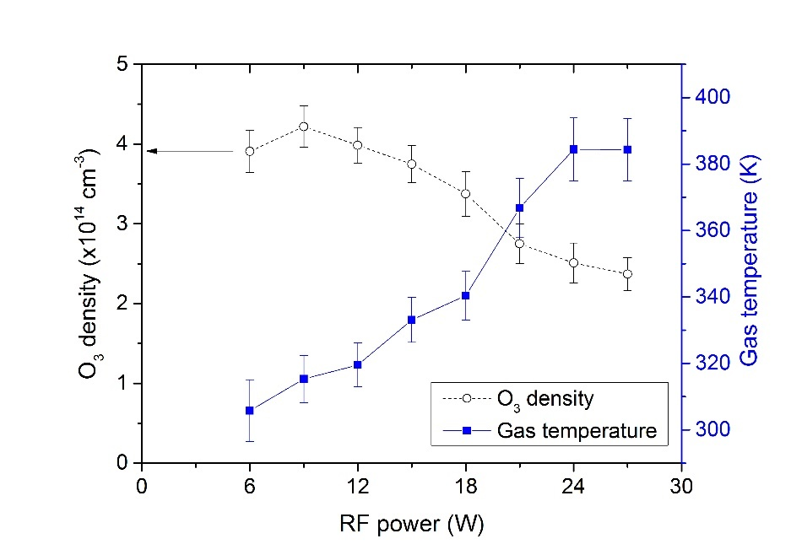
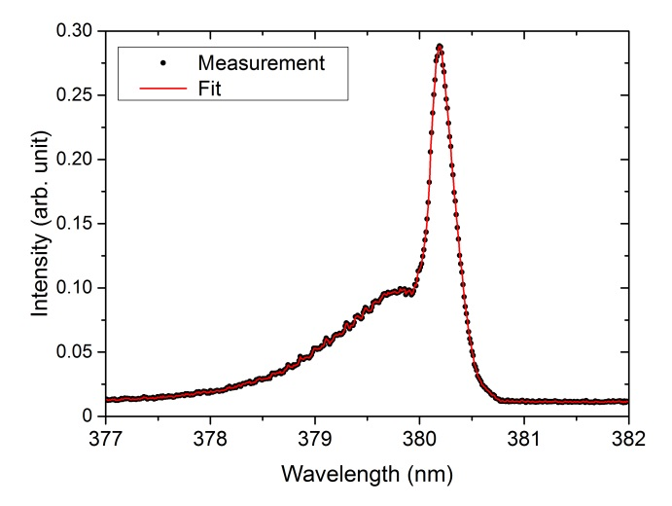
O₃ absorption spectroscopy
N2 emission – rotational T

Slide 24

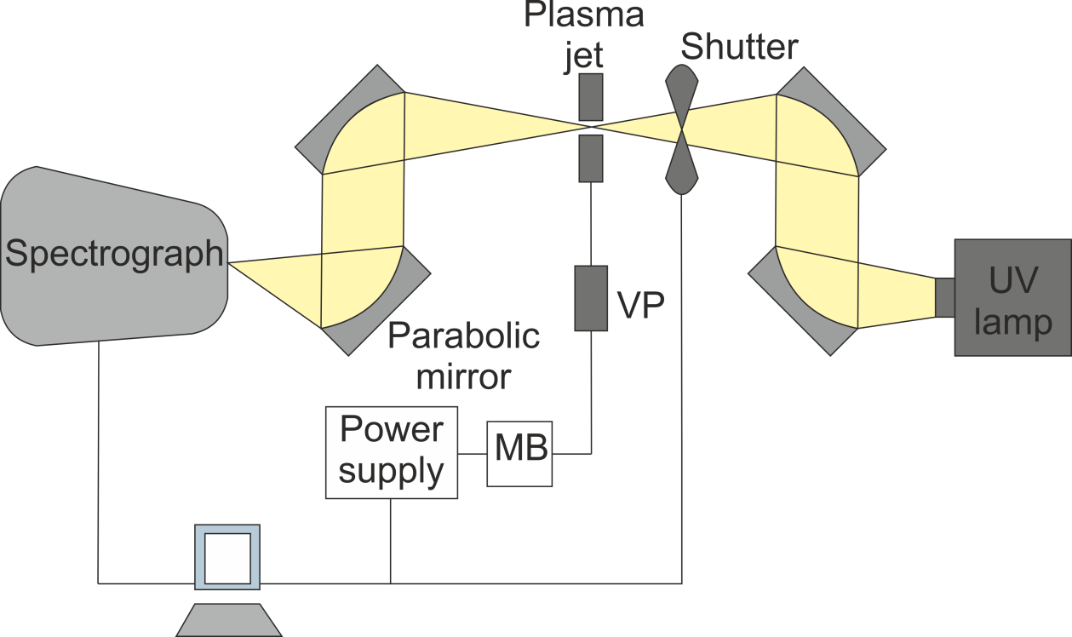
OH absorption spectroscopy
He + H₂O
Detector

Slide 25
Advanced techniques

Slide 26
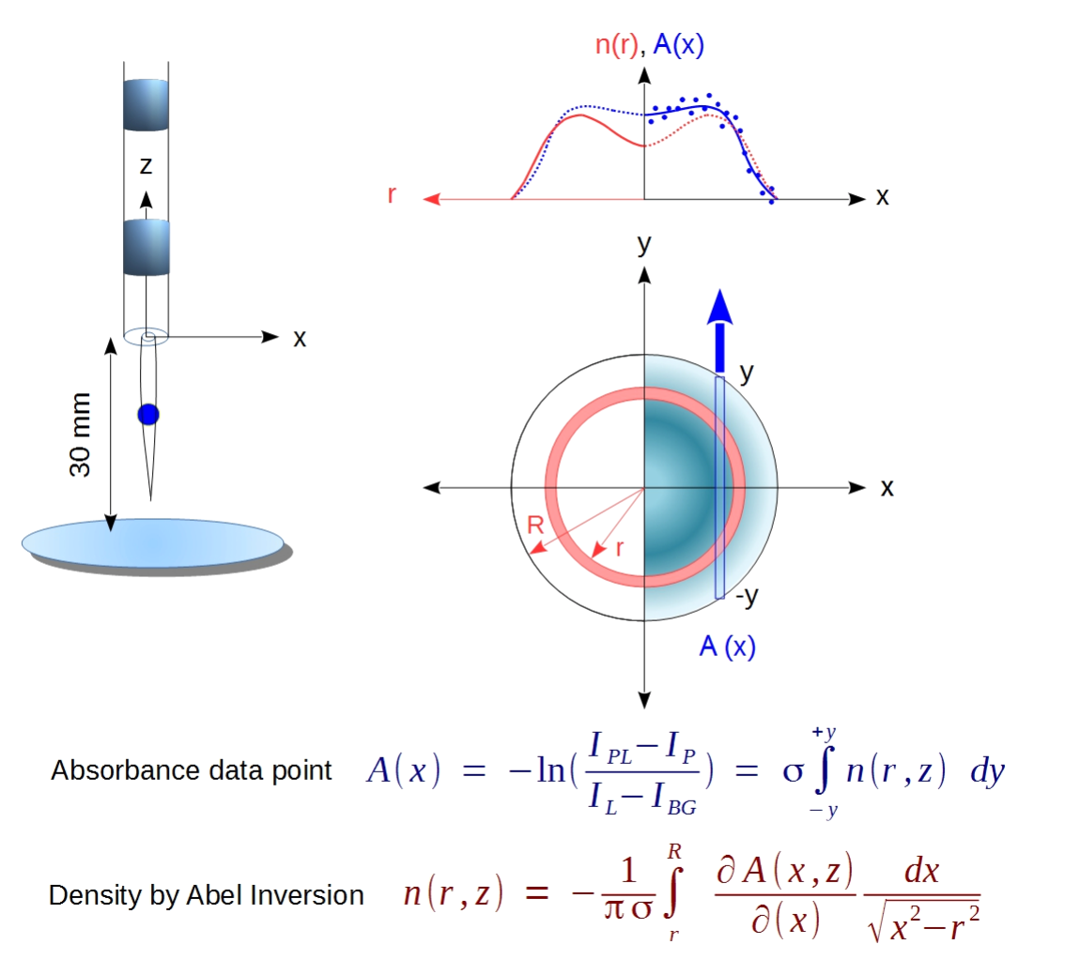
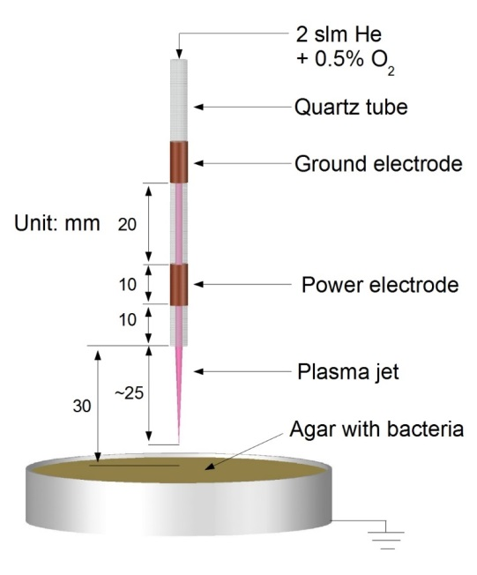
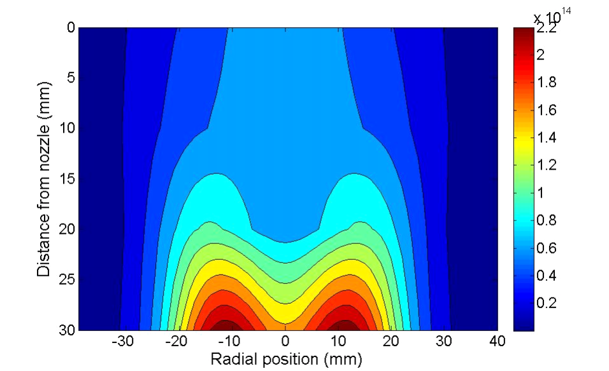
Abel transform
Problem 1: No spatial resolution
Solution: Abel transform of signal (for spherically symmetric plasmas)

Slide 27
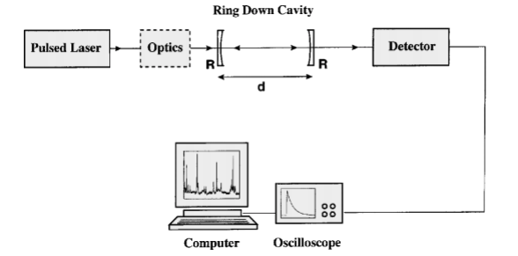

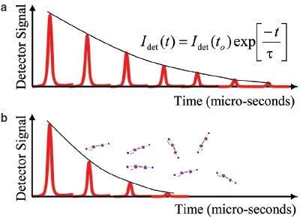
Cavity ringdown spectroscopy
Problem 2: Not enough signal
Solution: Multipass cells for higher effective absorption length
Cavity ringdown absorption spectroscopy
Measurement of absorption coefficient through decay time

Slide 28

Thank you!
-
Questions?

